Slide 1
Vibhaag Web App
A college analytics, session monitoring and
management tool
By,
Sudhanva N
PES1201702260
Karthik D
PES1201702449
Harsha K Y
PES1201801839
Guide:
Dr Veena S,
Chairperson,
Department of Computer
Applications

Slide 2
Abstract
The application consists of two components
The web application which helps monitor and manage the activities of the college
The mobile application for end users that acts as a companion and authentication tool
It records the time, date and location of the incident by a QR Code and sends the data securely to the web application

Slide 3
Literature Survey
There are n number of applications which are both free and proprietary. The process of building this application had references to the following applications.
Replicon - is a configurable time and attendance platform enables your organization to manage dispersed workforce. Employees can provide inputs from the field using our advanced mobile app. Supervisors gain complete control over employee availability, time off and scheduling.
Jibble - Manage time & attendance for team. Employees can clock in, punch in or as we say, jibble in and out using the iPad Kiosk, Web or Mobile (iOS & Android). Work hours are accurately captured including activities and notes. Generate automated timesheets, activity/project tracking, client billing and powerful reporting for your team. Whether you are running a tech startup, consulting firm, or running the local restaurant, Jibble helps you with payroll, billing or team productivity
TrackerPal - Time and Attendance Software with Geofencing. Easily manage remote and field employee attendance. Employees punch in and out using their mobile phone. Optional selfie. You can specify a location for attendance. Supports leave request and approval.
TimeCamp - In its mobile version, TimeCamp helps users to track time automatically to specific projects, whether new or existing ones, and change the time entries manually. This attendance tracking software can also be set up on Android and iPhone and other mobile devices which run the iOS platform.
Many of these applications are built focusing employee management and not solely around attendance management. This applications focus is to make the attendance management and generate a report which can be used to improve the efficiency of the organization.

Slide 4
Introduction
Custom time table for every batch and for every session
Faculties can confirm the class conduction using mobile apps with timings
Meaningful insights such as daily and weekly abstracts can be generated
Admins have the ability to change the time table and re-allocate faculties as per requirement

Slide 5
Tools and Technologies
Core
Deployment
Backend:
Node.js v10.x, Express.js v8.x
Frontend:
React.js v16.x, Redux v16.x
Database:
MongoDB v4.x
Testing:
Mocha, Postman
DevOps:
Github, Travis CI, AWS, Heroku
Other Tools:
Draw.io, Balsamiq

Slide 6
Functional Requirements
User authorization and authentication with role management
User should have restricted access, permission based creation of departments, faculty or any other entity
Customized schedules for sessions for different user or group along with notifications
Create departments, sessions, add faculty, add subjects

Slide 7
Non - Functional Requirements
Performance: Application is build keeping scalability in mind meaning that is can serve lots of users without fail
Availibility: Since it is an online application, it is available at all times as long the user has an active internet connection
Maintainability: Version control with continuous integration and continuous delivery for seamless development operations
Data Integrity: Data is store in multiple nodes as a backup in case of emergenices or recovery

Slide 8
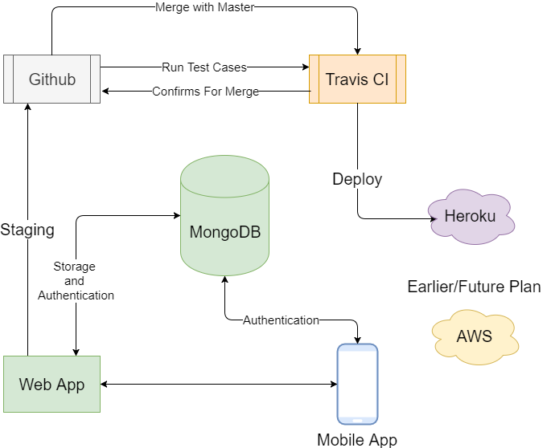
Data Flow

Slide 9
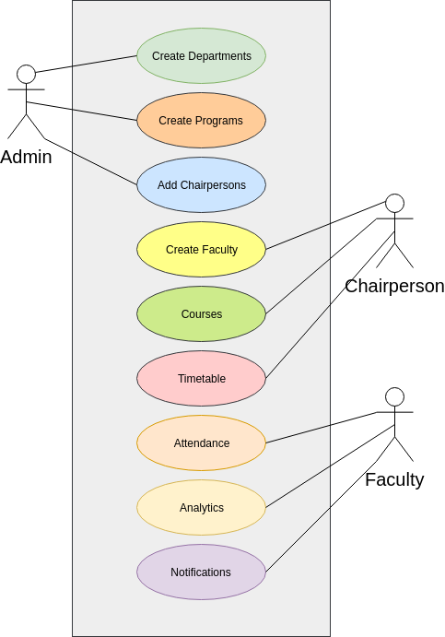
Use Cases

Slide 10
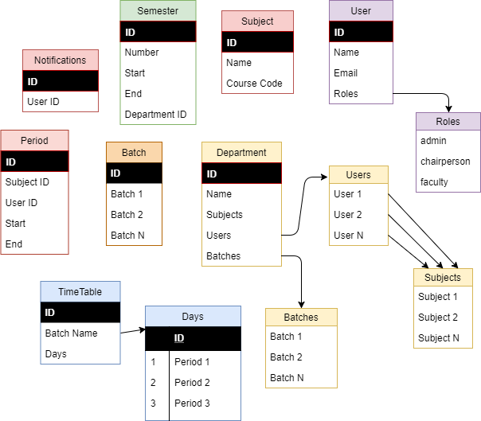
Database
Structure

Slide 11
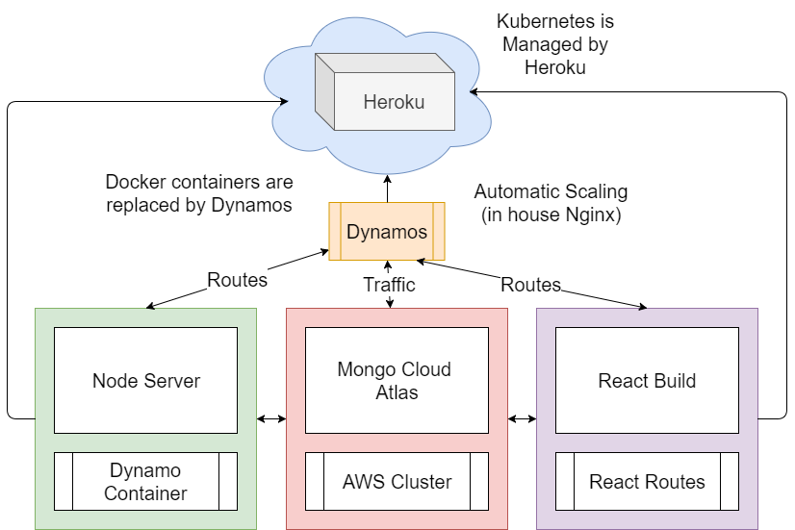
Implemented
Architecture

Slide 12
Test Cases

Slide 13
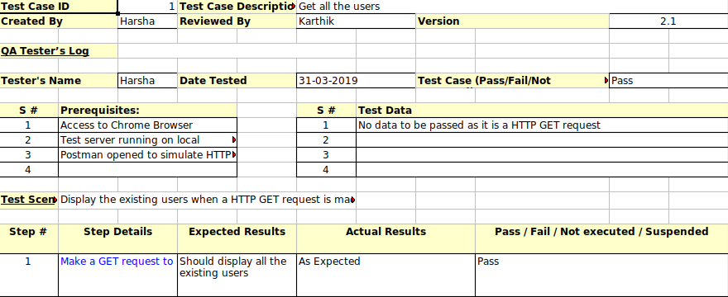

Slide 14
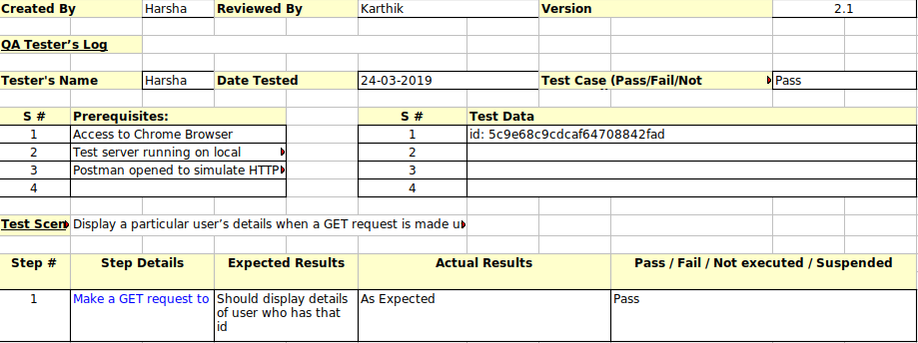

Slide 15
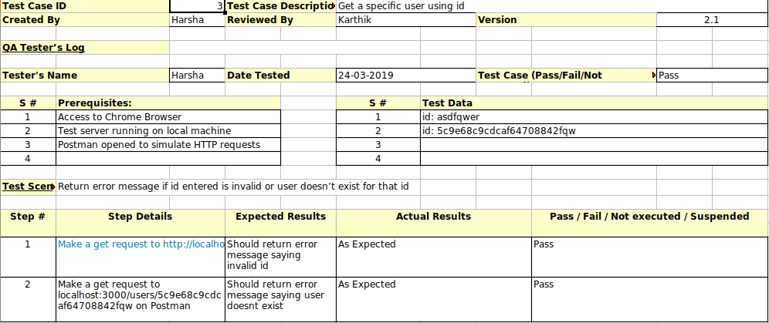

Slide 16
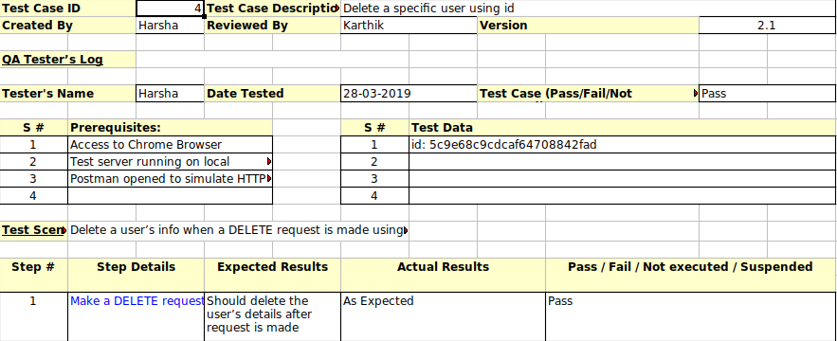

Slide 17
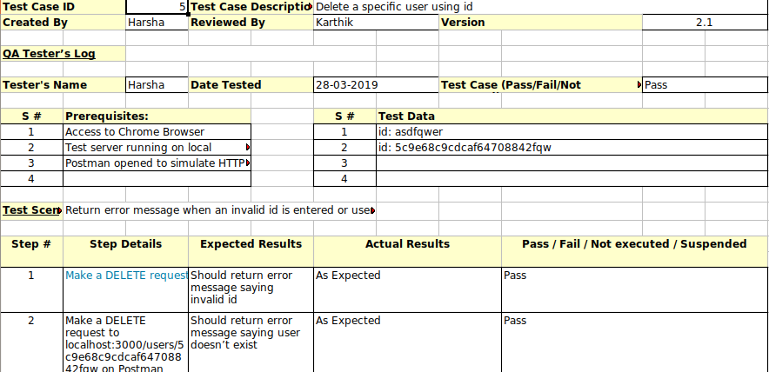

Slide 18
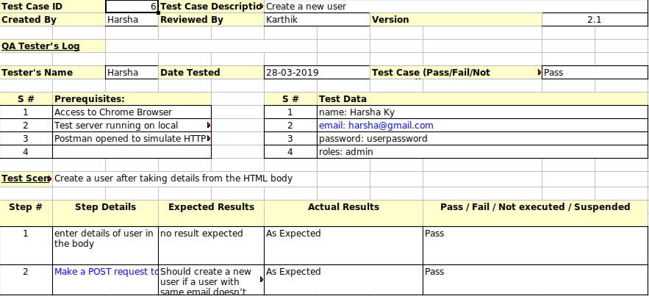

Slide 19
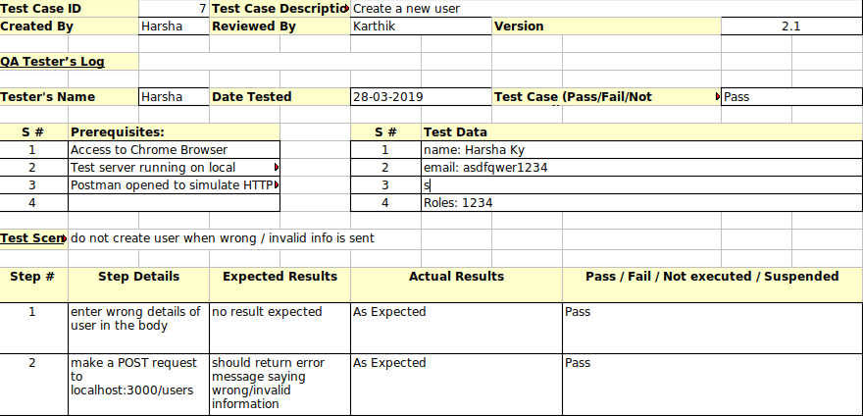

Slide 20
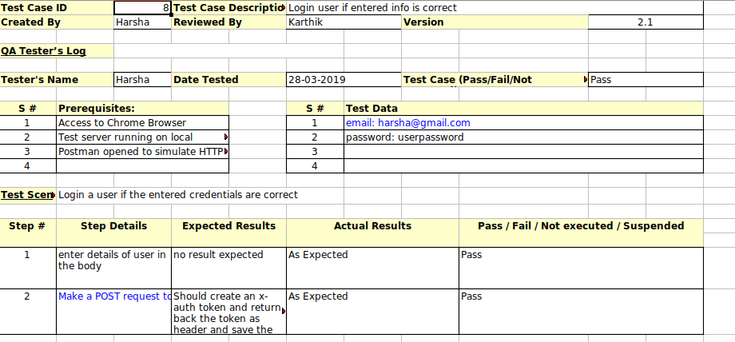

Slide 21
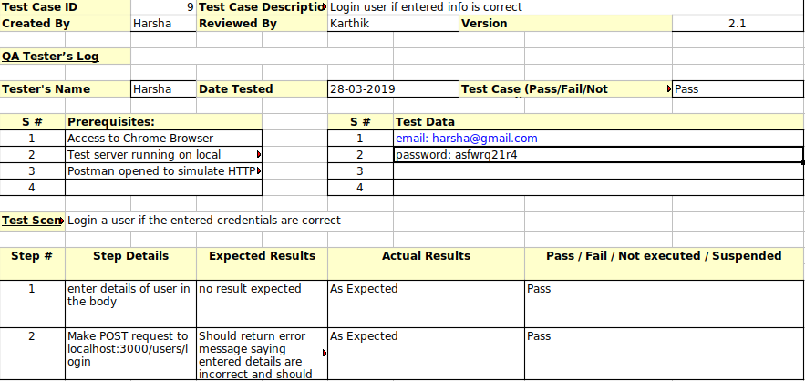

Slide 22
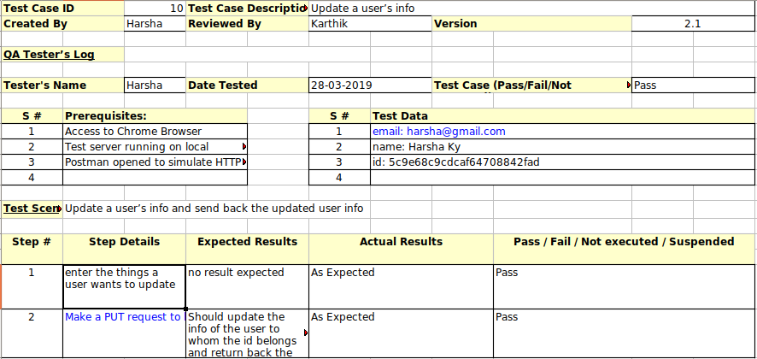

Slide 23
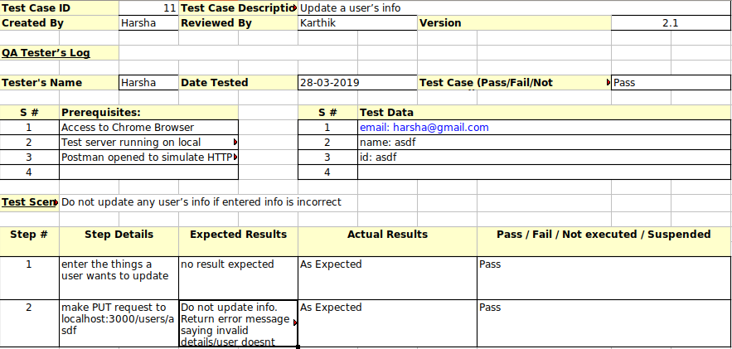

Slide 24
Conclusion
This application tries to solve a real life problem at an affordable cost. It takes the best features of few applications and embeds them in itself.
This application is simple, user friendly and has a formal UI.
The project is currently under the development phase where it is being tested for accuracy and reliability.
It will help every enterprise in making their day to day processes easier and accountable.
Further plan is to deploy the product inany enterprise organization which strive for quality.

Slide 25
Bibiliography
ReactJS documentation: https://reactjs.org/
Redux documentation: https://redux.js.org/
NodeJS documentation: https://nodejs.org/en/
Firebase documentation: https://firebase.google.com
Medium and freecodecamp blogs: 1
https://medium.freecodecamp.org/understanding-redux-the-worlds-easiest-guide-to-beginning-redux-c695f45546f6
https://medium.freecodecamp.org/a-beginners-guide-to-redux-9f652cbdc519
https://medium.freecodecamp.org/these-are-the-concepts-you-should-know-in-react-js-after-you-learn-the-basics-ee1d2f4b8030
https://medium.freecodecamp.org/what-exactly-is-node-js-ae36e97449f5

Slide 26
Future Enhancement
Now the application records the actual event based on QR-Code scanned. In future, Geo co-ordinates based authentication, like co-ordinates of classroom, will be more efficient
Now the application depends on user’s email and password for account validation. In addition to that device fingerprint authentication is necessary.

Slide 27
Demo

